Slide 1

ABC Company’s Financial Dashboard
Lucky Suman

Slide 2
Dashboard using Power BI tool
The EDA part is done in Python. Now dashboard is made using the Power BI tool.
First of all, the cleaned data is loaded and transformed.
With Column quality, column distribution, and column profile options of Power BI, it has been gathered that data types of ‘Amount Paid’ and ‘Settlement Date’ are changed while transforming data.
After correcting the data types and checking the data, the dashboard is created by using DAX functions, visualization charts, measures, columns, and tooltips.

Slide 3
Dashboard pages
The dashboard contains 6 pages:
Home
Summary
Income
Payment
Net Income
Ask a Question
The dashboard also contains 2 more pages which are used for tooltips.

Slide 4
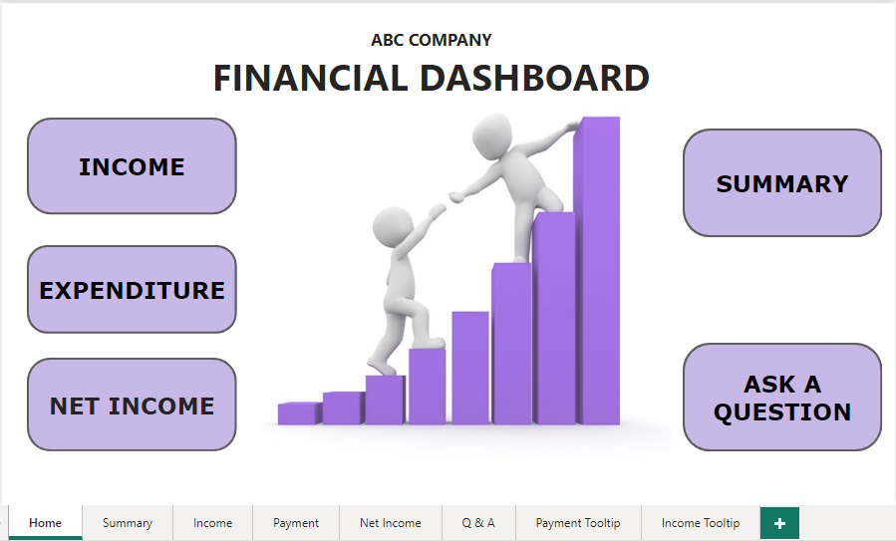
Home Page This page shows the buttons navigating to all the other pages.

Slide 5
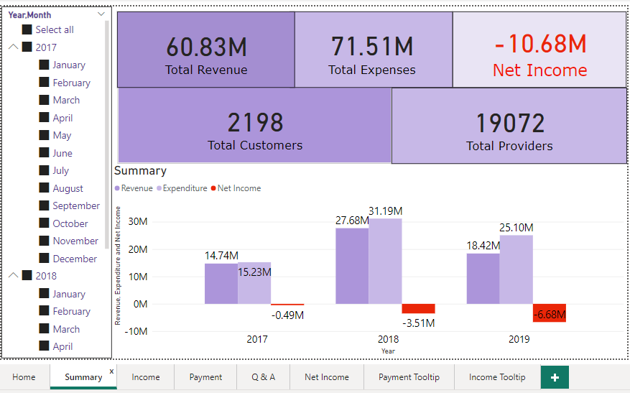
SUMMARY PAGE
This page shows all the important cards, patterns of revenue, and expenditure including net income over time.

Slide 6
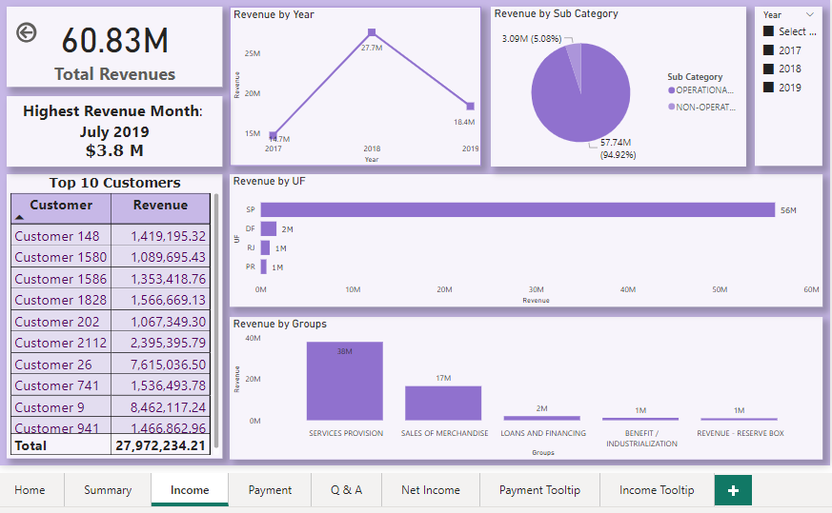
INCOME PAGE This page shows all the insights and trends of income including top 10 customers.

Slide 7
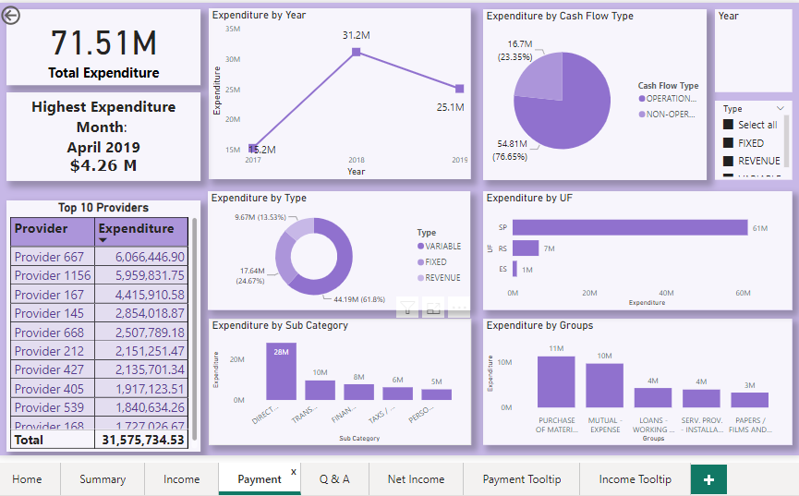
Payment Page This page shows all the insights and trends of expenditures including top 10 providers.

Slide 8
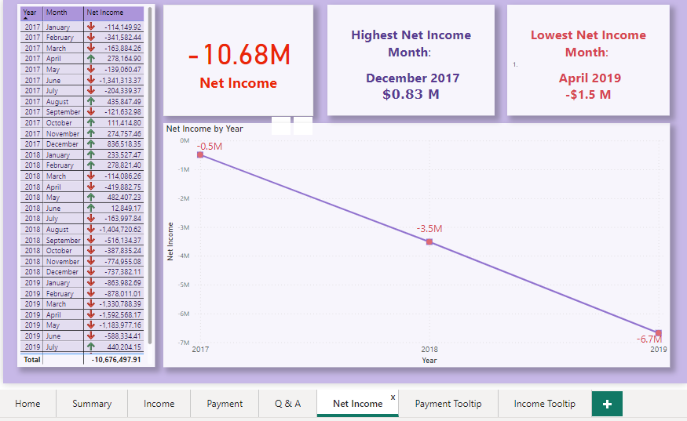
Net Income Page This page shows the net income over the period of 3 years. It also shows that the company is in loss from continuous 3 years.

Slide 9
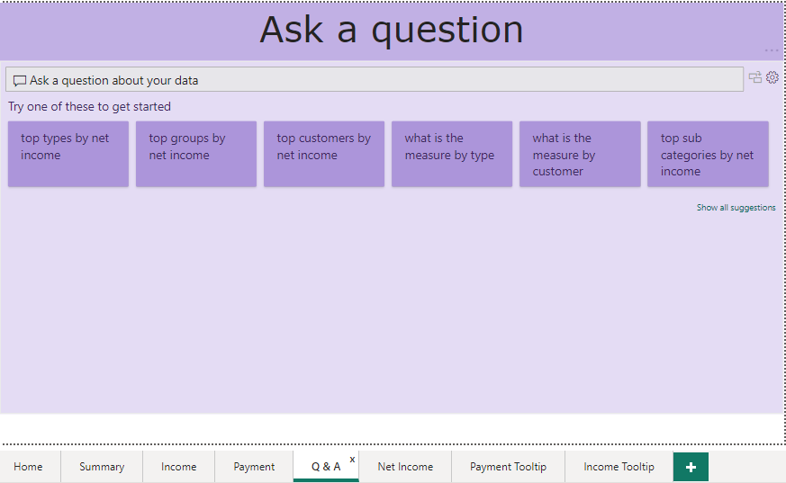
Q & A Page This is a Question and Answer page(Natural Language Query)

Slide 10
THANK YOU

